Slide 1

Spaceship Titanic
Predict which passengers are transported to an alternate dimension
Lorenzo Soricone
Claudia Lara Cordova
Victor Navarro Santos

Slide 2

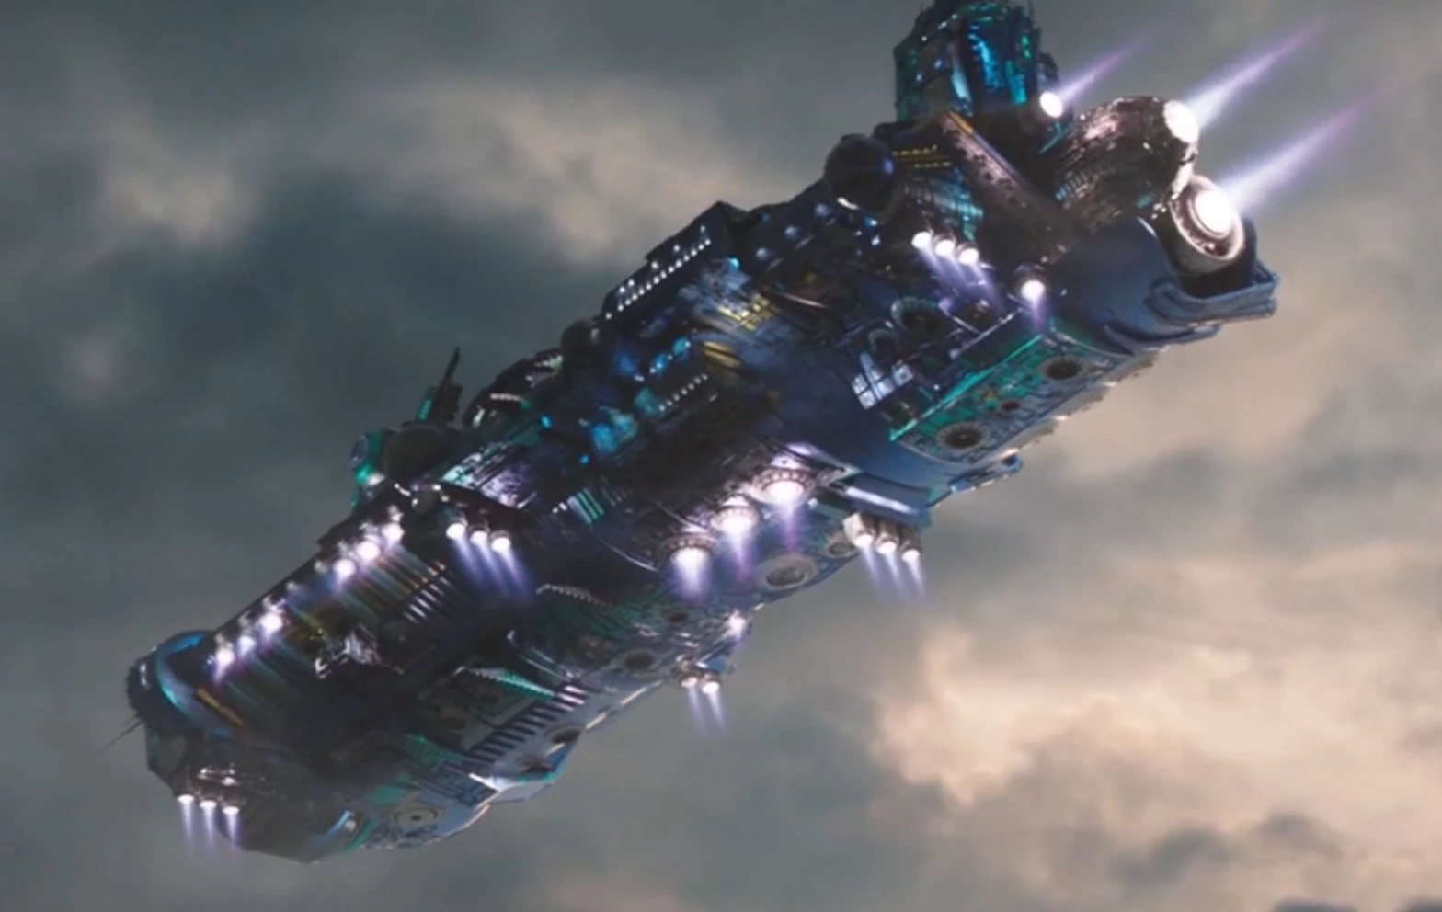
Welcome to the year 2912
This project aims to predict the survival of passengers on the fictional Spaceship Titanic using machine learning techniques. The dataset includes various features such as passenger demographics, spending patterns, and cabin information.
The goal is to build a robust model that can accurately classify whether a passenger was transported or not.

Slide 3


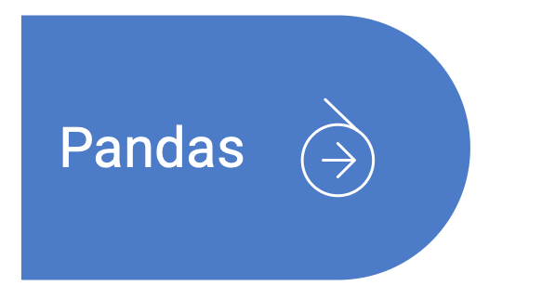
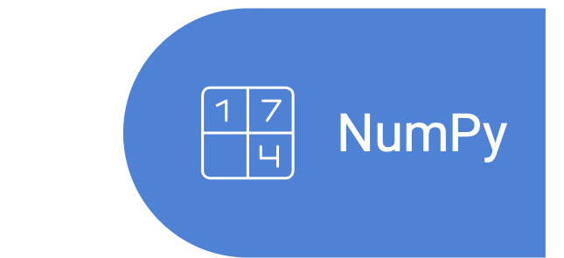
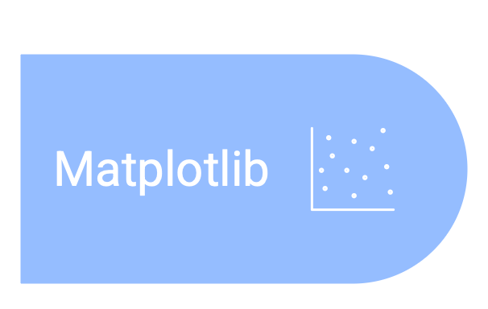
Tools
Programming language for data analysis
Library for data manipulation and analysis
Library for numerical computations in Python
Library for creating visualizations in Python

Slide 4

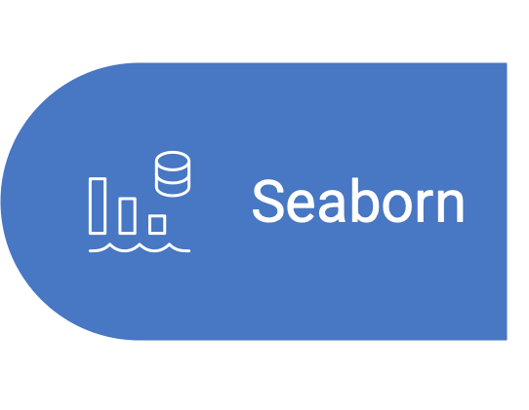
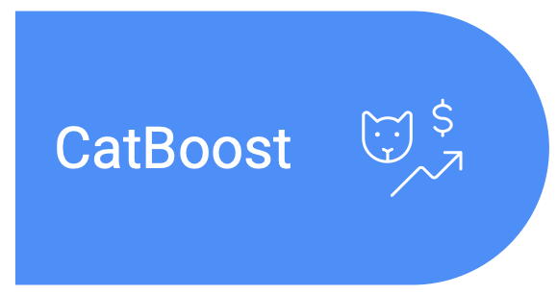
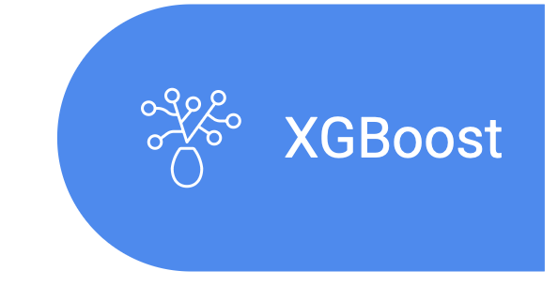

Tools
Machine learning algorithms implementation and model
building.
Data visualization library for creating plots.
Gradient boosting algorithm
Extreme gradient boosting
Efficient Python object serialization library

Slide 5

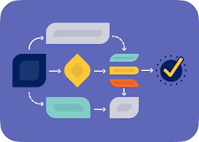
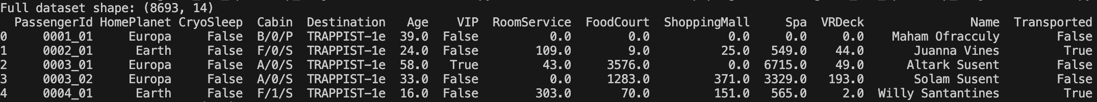
Data Analysis
Exploratory Data Analysis (EDA)
Analysis of features distributions
Spending pattern analysis
Features–Target Relationship Analysis
A data-set extract

Slide 6

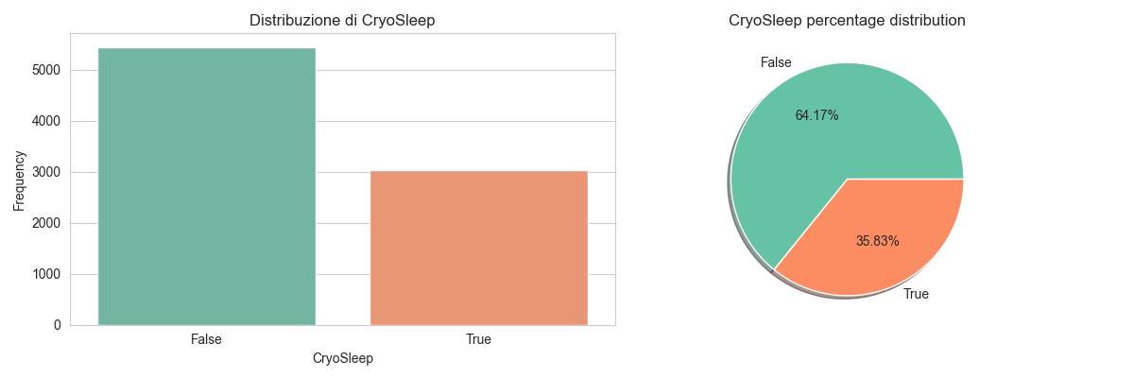
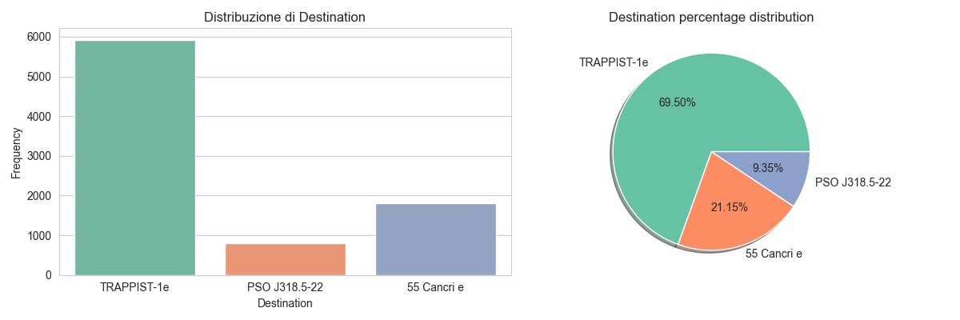
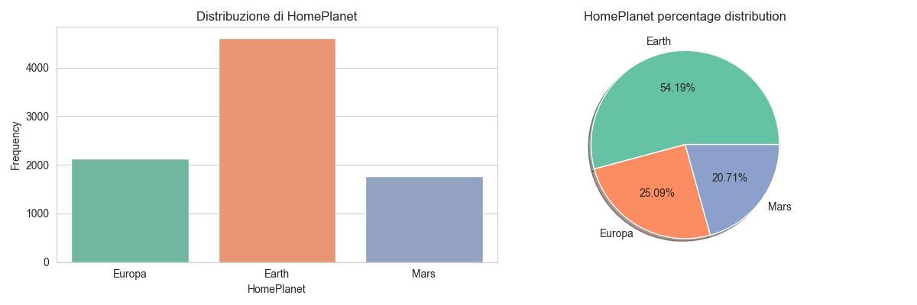
Distribution
Cryosleep distribution

Slide 7
Distribution
Destination distribution

Slide 8
Distribution
HomePlanet distribution

Slide 9
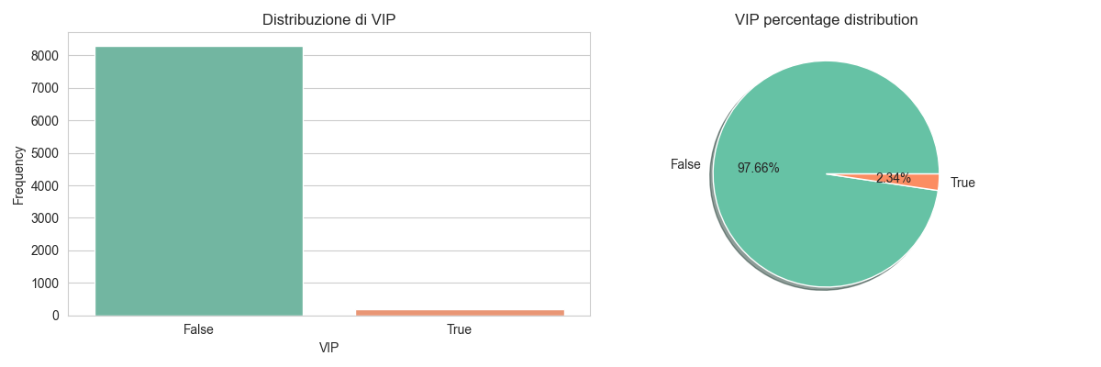
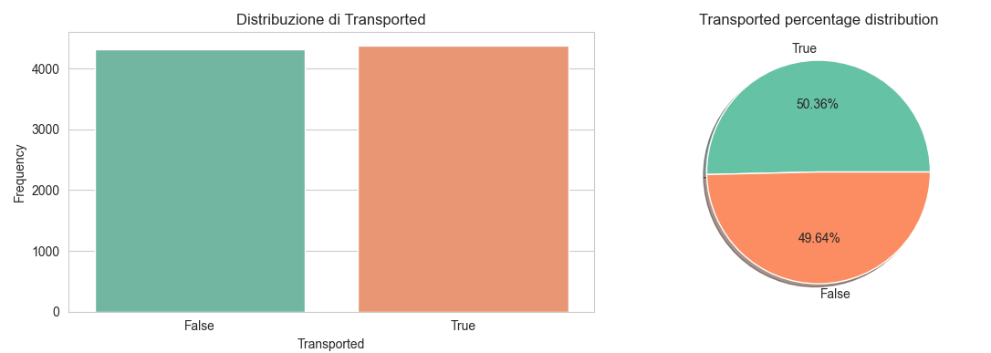
Distribution
VIP distribution
Transported distribution

Slide 10
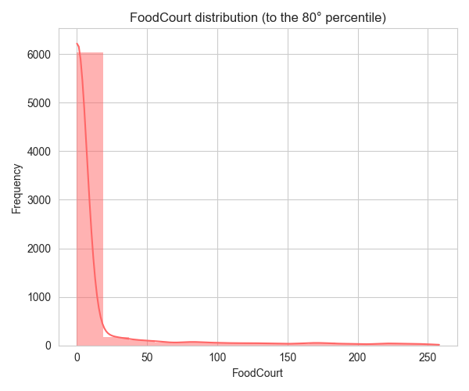
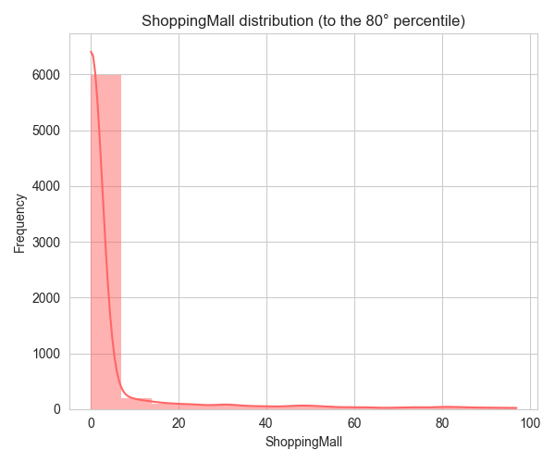
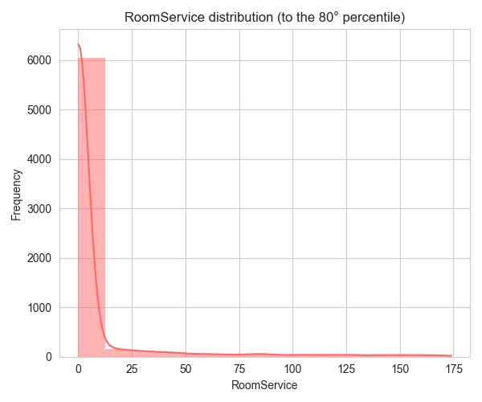
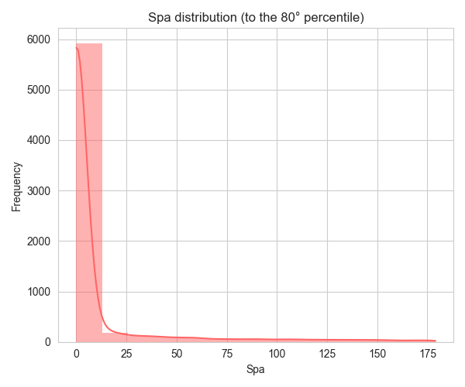
Distribution of Spending Categories
Most people spent very little
Standardization could be useful for scaling in linear models

Slide 11
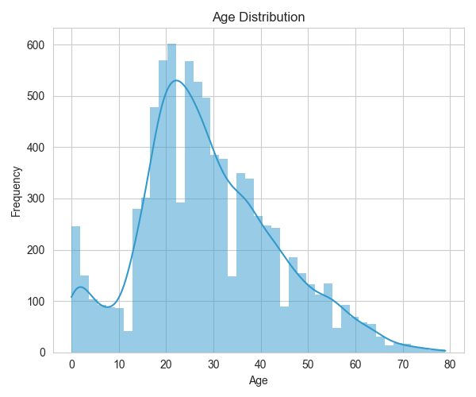
Age
distribution

Slide 12
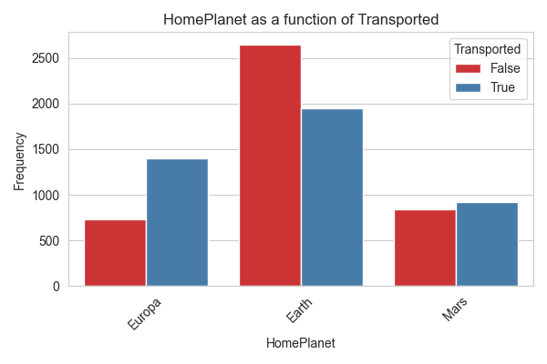
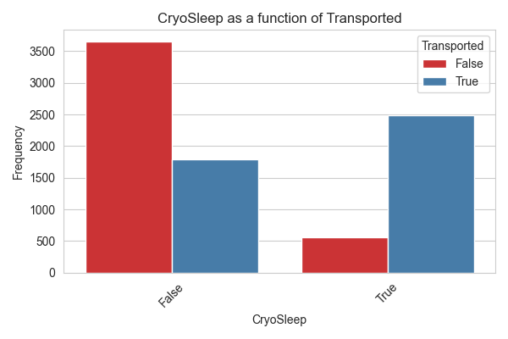
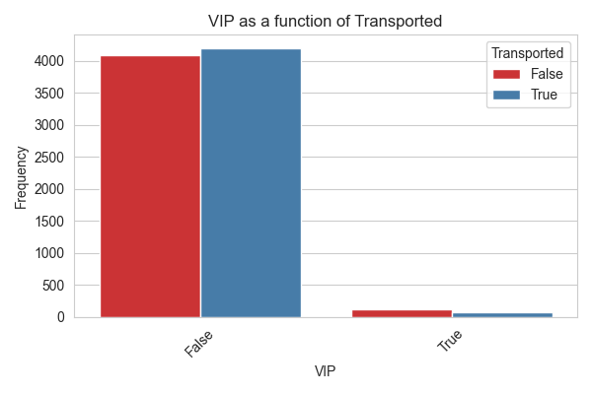
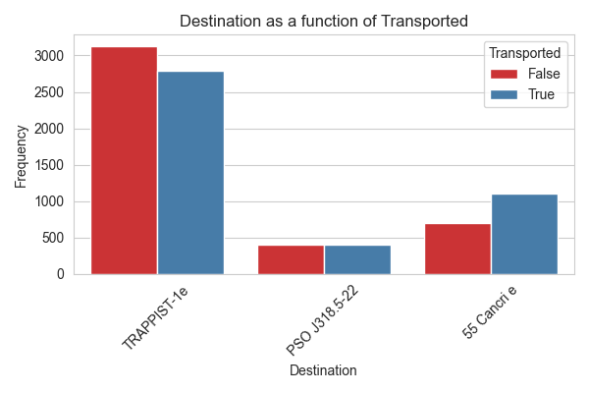

Slide 13
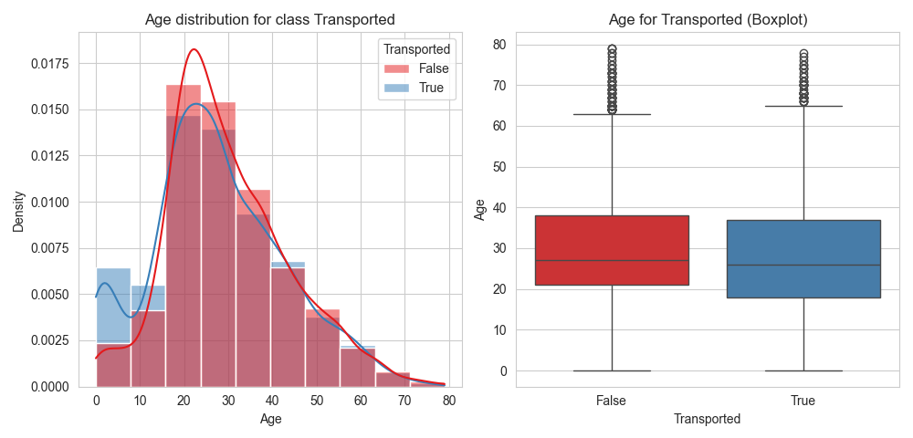
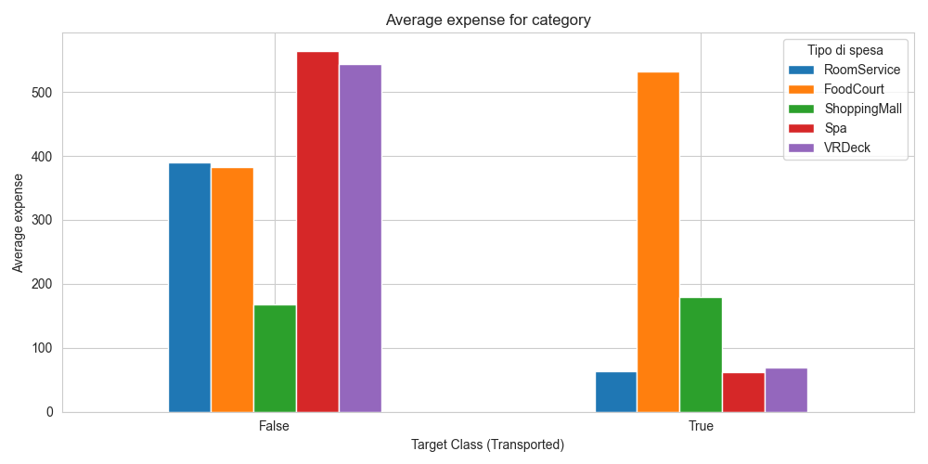
Age
distribution
for class
Expense for class Transported
Expense
for
class

Slide 14

Workflow
Prepocessor
Parameter grid/distributions
Pipeline
Model choice
Dataset
Holdout Split
Training set
GridSearchCV/RandomSearchCV
Best CV Accuracy
Best Parameters
Features importances
Test Set
Tuned model
Validation set
Submission.csv
Metrics Calculations
y-pred
y-train

Slide 15
Pipeline
Preprocessor (Data Preprocessing)
Creation of new features (Deck, Side, Grouped, FamilySize, TotalSpent)
Logical imputation based on family groups
Imputation of Cryosleep based on spending patterns
Classic preprocessing (KNNimputer/mean for numerical; mode for categorical)
Scaling of numerical features (normalization/standardization)
Encoding of categorical variables (OneHotEncoder)
Boolean to int of Cryosleep and VIP

Slide 16
Pipeline
Preprocessor (Data Preprocessing)
Creation of new features (Deck, Side, Grouped, FamilySize, TotalSpent)
Logical imputation based on family groups
Imputation of Cryosleep based on spending patterns
Classic preprocessing (KNNimputer/mean for numerical; mode for categorical)
Scaling of numerical features (normalization/standardization)
Encoding of categorical variables (OneHotEncoder)
Boolean to int of Cryosleep and VIP
3. Model Choices
Choices availabilities:
Random Forest
AdaBoost
SVM
XGBoost
CatBoost
Stacked Classifier

Slide 17


Final Steps
4. Metrics
Metrics calculated are:
Accuracy (CV, Val. , Train.)
Recall
Precision
Confusion Matrix
ROC Curve + AUC
5. Kaggle Submission
Final considerations
Genaration of file submission.csv
Submission on Kaggle and results visualization

Slide 18
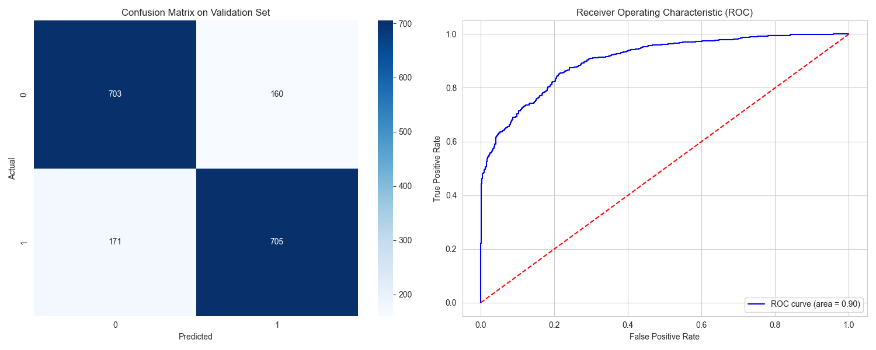
Random Forest

Slide 19
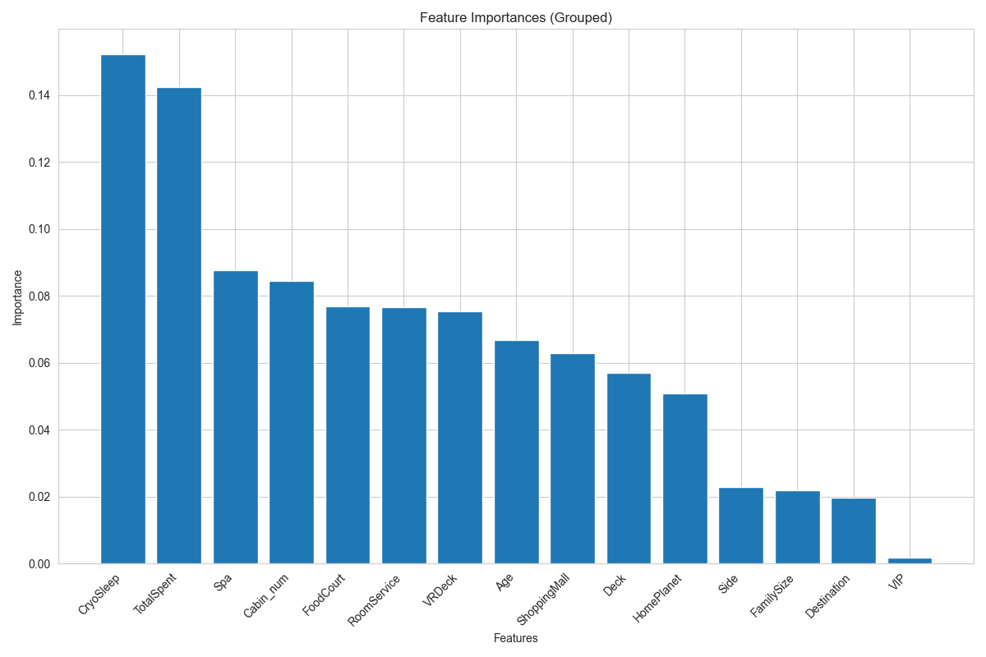
Random Forest
Best Parameters
Grid
Bootstrap | True
Max Depth | 15
Max Features | sqrt
Min Samples Leaf | 2
Min Samples Split | 5
N Estimators | 200
[True]
[5, 10, 15]
[sqrt, log2]
[2, 4, 6]
[5, 10]
[200, 300, 400]
Accuracies
Best CV Accuracy | 0.8056
Val. Accuracy | 0.8097
Tr. Accuracy | 0.9090
 | 0 | 1
Precision | 0.80 | 0.82
Recall | 0.81 | 0.80

Slide 20
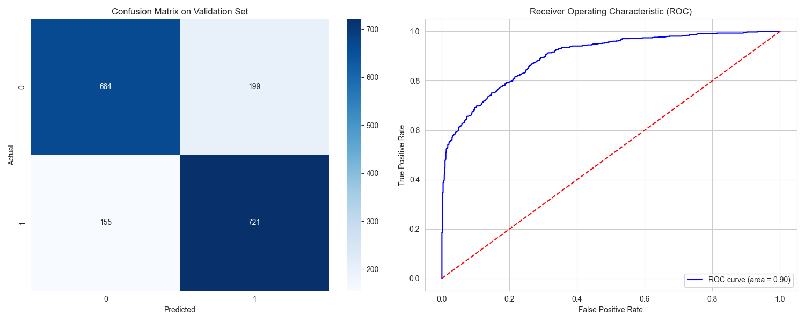
AdaBoost

Slide 21
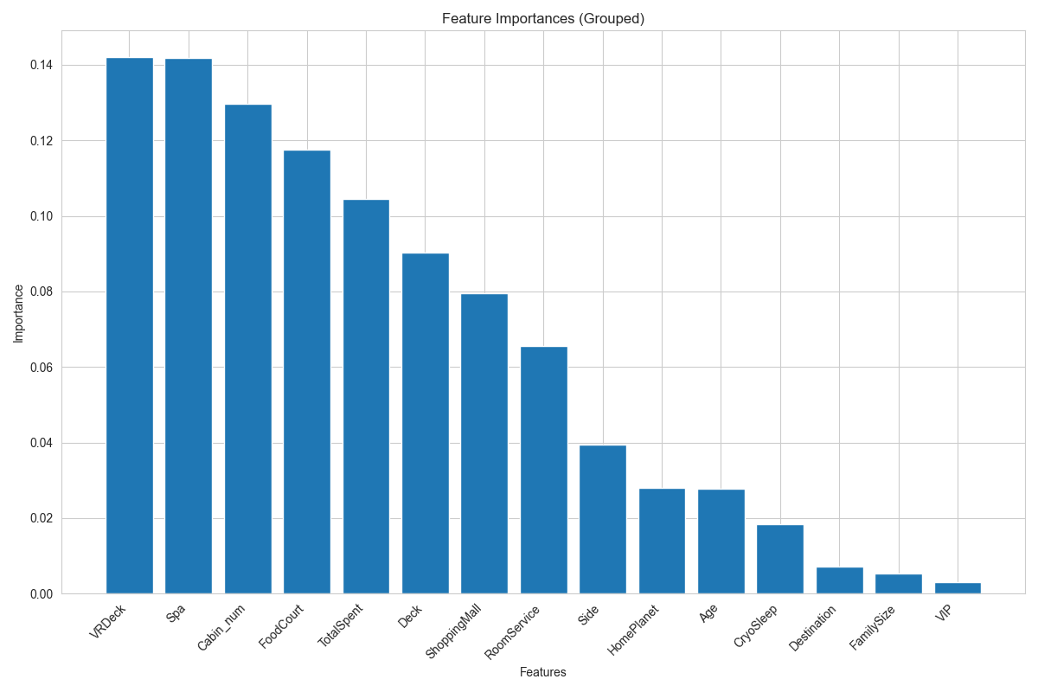
AdaBoost
Best Parameters
Grid
Base Estimator | Dec. Tree (Depth=3) | Dec. Tree (Depth = [1,2,3]
Learning Rate | 1.0 | [0.5, 1.0]
N Estimators | 300 | [100, 200, 300]
Accuracies
Best CV Accuracy | 0.8007
Val. Accuracy | 0.7964
Tr. Accuracy | 0.8228
 | 0 | 1
Precision | 0.81 | 0.78
Recall | 0.77 | 0.82

Slide 22

SVM

Slide 23
SVM
Best Parameters
Grid
C | 10 | [0.1, 1, 10, 100]
Gamma | scale | [scale, auto, 0.01, 0.1, 1.0]
Kernel | rbf | [linear, rbf]]
Accuracies
Best CV Accuracy | 0.8060
Val. Accuracy | 0.8045
Tr. Accuracy | 0.8394
 | 0 | 1
Precision | 0.80 | 0.81
Recall | 0.81 | 0.80

Slide 24

XGBoost

Slide 25
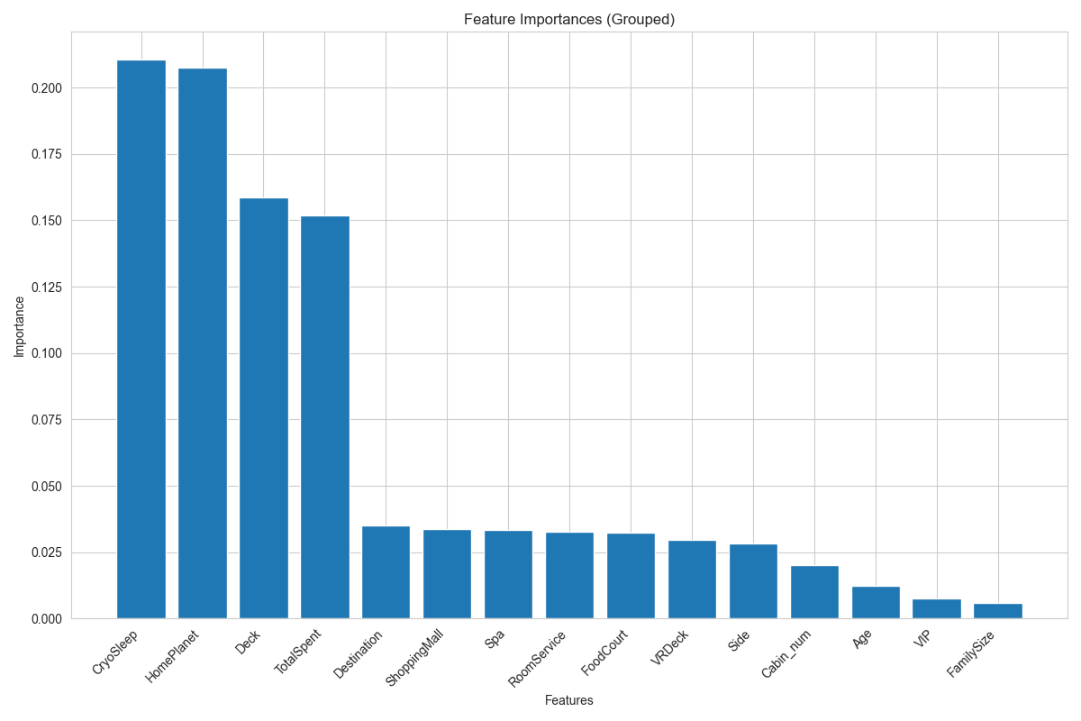
XGBoost
Best Parameters
Grid
Learning Rate | 0.05 | [0.05, 0.1, 0.2]
Max Depth | 4 | [3, 4, 6]
N Estimators | 300 | [100, 200, 300]
Subsample | 1.0 | [0.8, 0.9, 1.0]
Accuracies
Best CV Accuracy | 0.8132
Val. Accuracy | 0.8097
Tr. Accuracy | 0.8506
 | 0 | 1
Precision | 0.82 | 0.80
Recall | 0.80 | 0.82

Slide 26

CatBoost

Slide 27
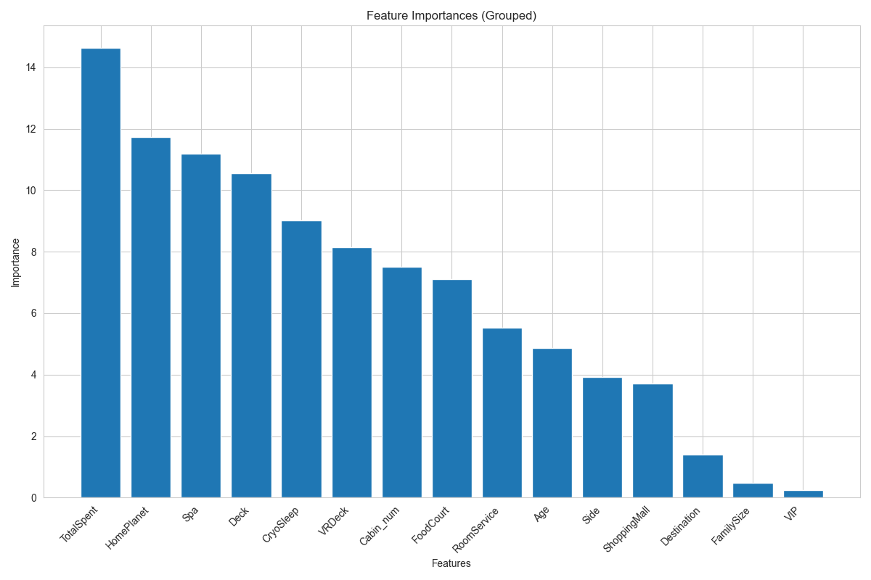
CatBoost
Best Parameters
RandomGrid
Random Strength | 2 | [0.5, 1, 2, 5]
Learning Rate | 0.02 | [0.02, 0.05, 0.07, 0.1, 0.15, 0.2]
12 Leaf Reg. | 3 | [1, 3, 5, 7, 9, 11]
Iterations | 1250 | [500, 750, 1000, 1250, 1500]
Depth | 4 | [4, 5, 6, 7, 8, 9, 10]
Border Count | 64 | [32, 64, 128, 254]
Bagging Temperature | 0.5
[0, 0.5, 1, 2]
Accuracies
Best CV Accuracy | 0.8141
Val. Accuracy | 0.8129
Tr. Accuracy | 0.8458
 | 0 | 1
Precision | 0.83 | 0.80
Recall | 0.78 | 0.84

Slide 28

Stacked Classifier

Slide 29
Stacked Classifier
Best Parameters | Grid
Final Estimator C | 1 | [0.1, 1, 10]
Accuracies
Best CV Accuracy | 0.8155
Val. Accuracy | 0.8097
Tr. Accuracy | 0.8631
 | 0 | 1
Precision | 0.83 | 0.79
Recall | 0.78 | 0.84

Slide 30

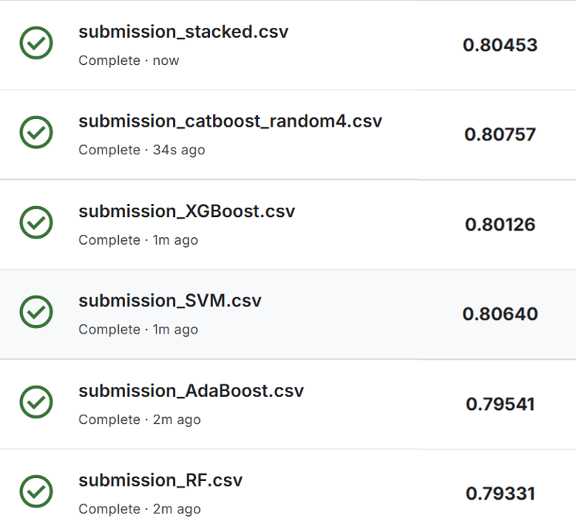


Classification
Thanks for your attention!

